Slide 1
Numerical on Histogram

Slide 2
In a 2-week study of the productivity of workers, the following data were obtained on the total number of acceptable pieces which 100 workers produced
65 36 49 84 79 56 28 43 67 36
43 78 37 40 68 72 55 62 22 82
88 50 60 56 57 46 39 57 73 65
59 48 76 74 70 51 40 75 56 45
35 62 52 63 32 80 64 53 74 34
76 60 48 55 51 54 45 44 35 51
21 35 61 45 33 61 77 60 85 68
45 53 34 67 42 69 52 68 52 47
63 65 55 61 73 50 53 59 41 54
41 74 82 58 26 35 47 50 38 70
Construct the frequency table having 7 classes for above data
Construct HISTOGRAM for the above data
Draw a frequency polygon
Draw Ogive curve

Slide 3
Solution
Max. Value= 88
Min. Value=21
No.of class=7
Therefore,
Class interval= 88-21 = 9.5 =10 acceptable pieces
7

Slide 4
Class Mark= upper class limit+ lower class limit
2
Class Boundaries = (Lower limit-0.5 ,upper limit+0.5)

Slide 5
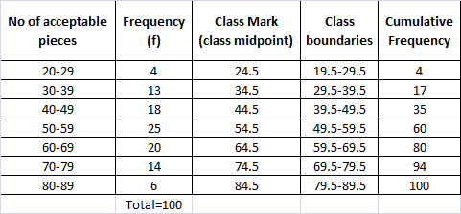

Slide 6
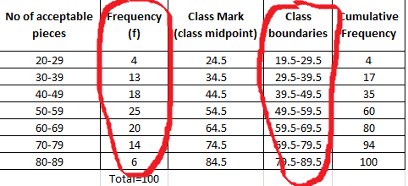
Construction of Histogram

Slide 7
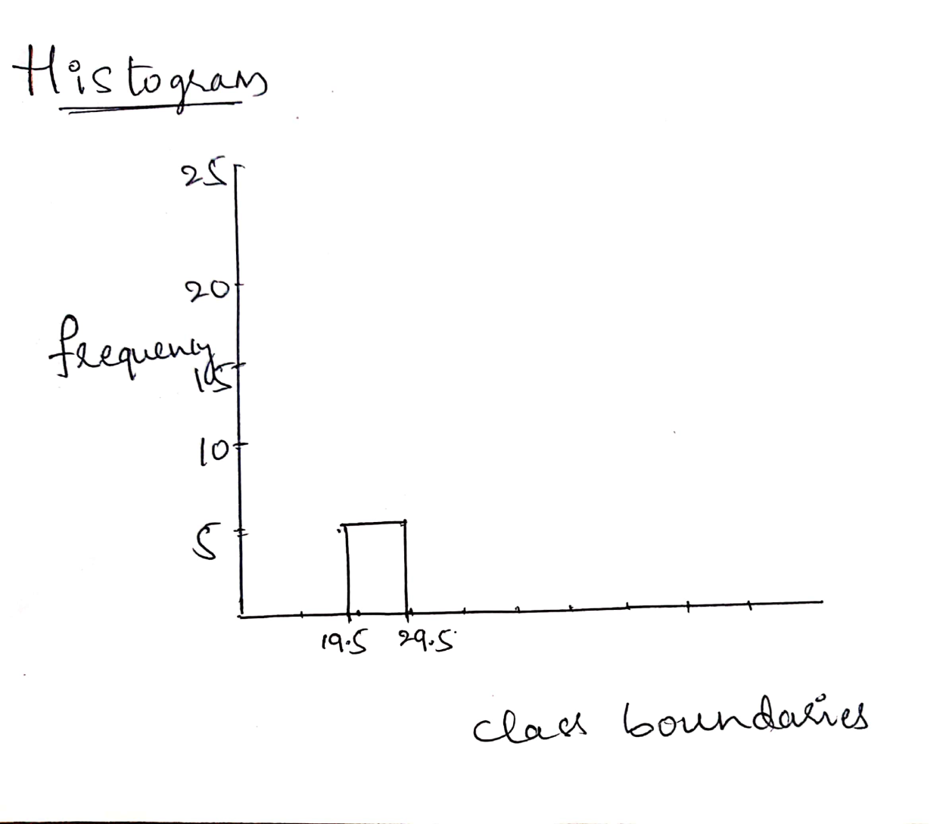
Construction of Histogram

Slide 8
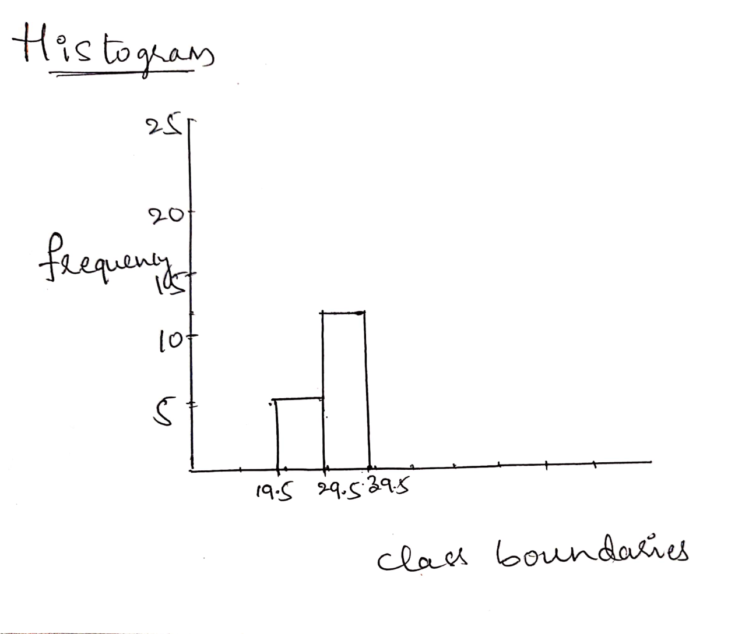
Construction of Histogram

Slide 9
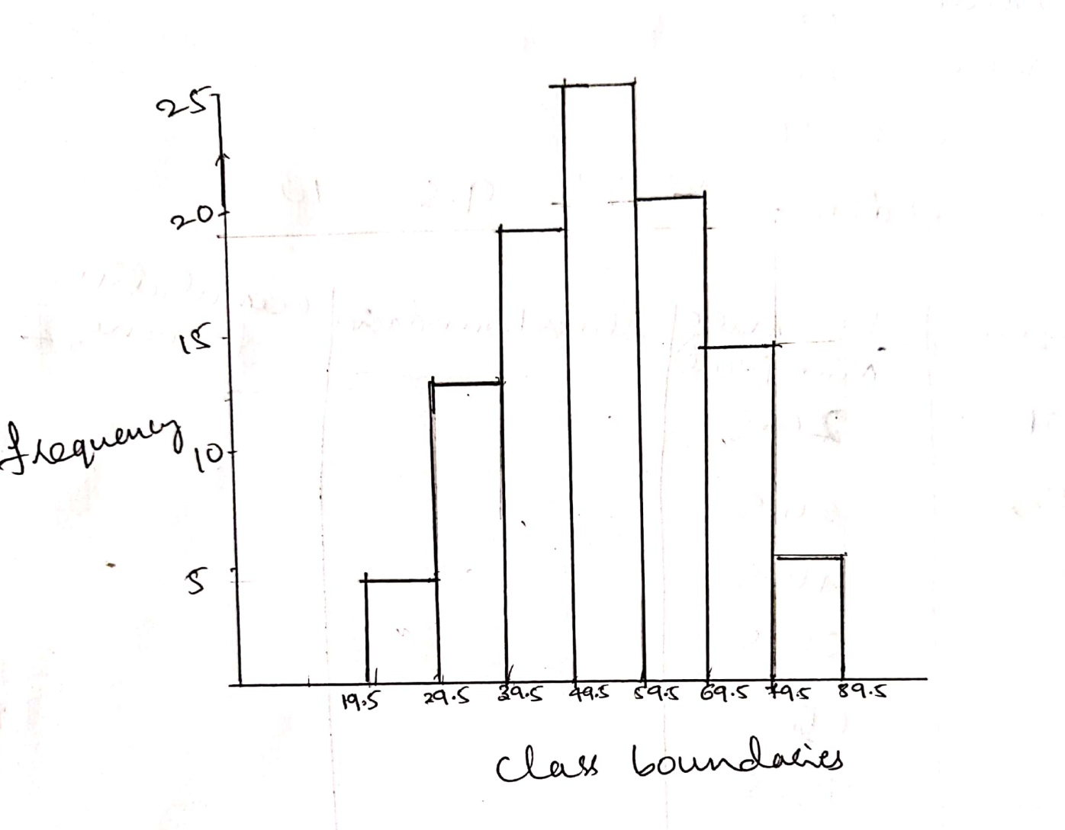
Construction of Histogram

Slide 10
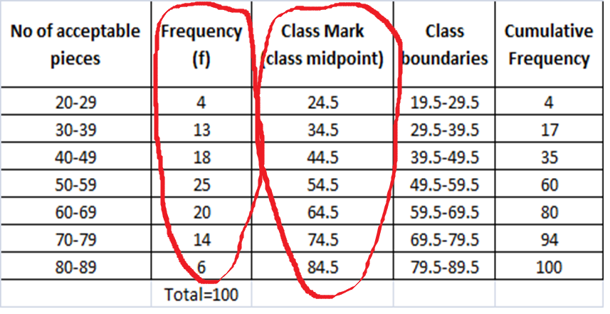
Construction of frequency polygon

Slide 11
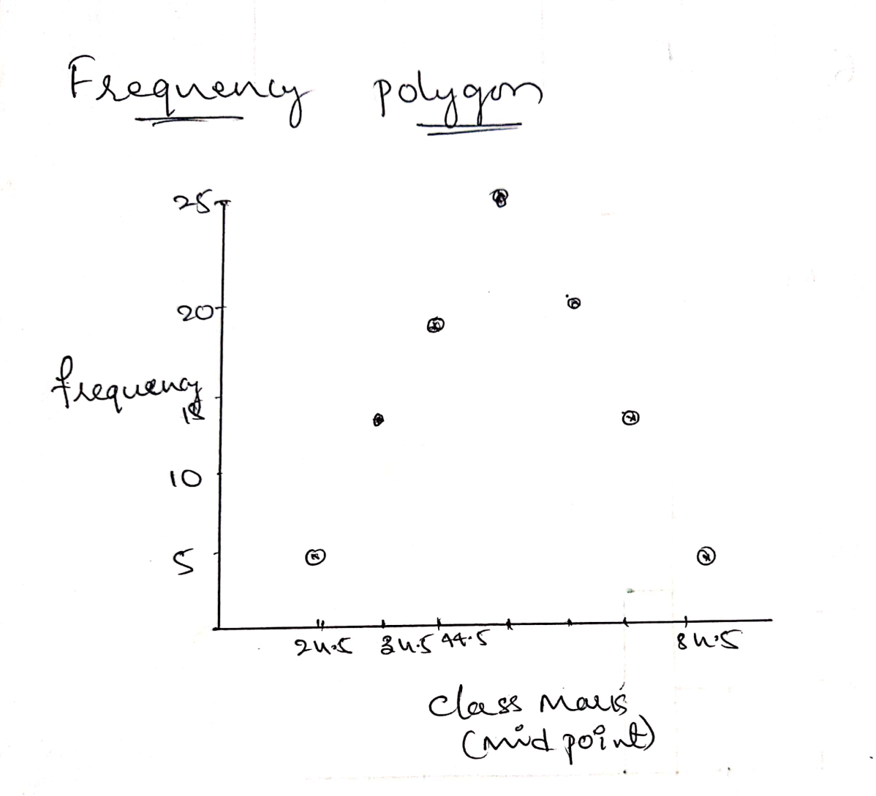
Construction of frequency polygon

Slide 12
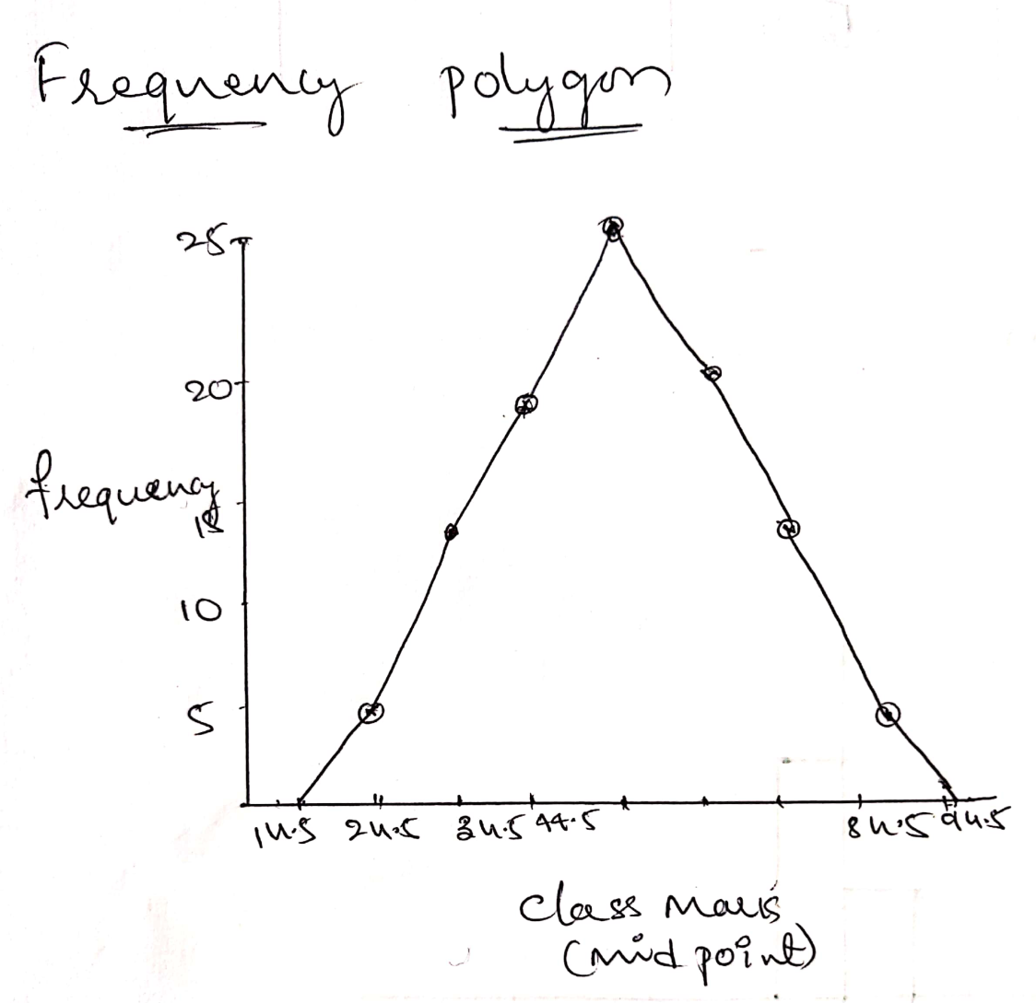
Construction of frequency polygon

Slide 13
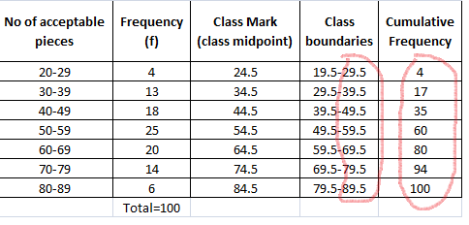
Construction of Ogive graph
X-axis
Y--axis

Slide 14
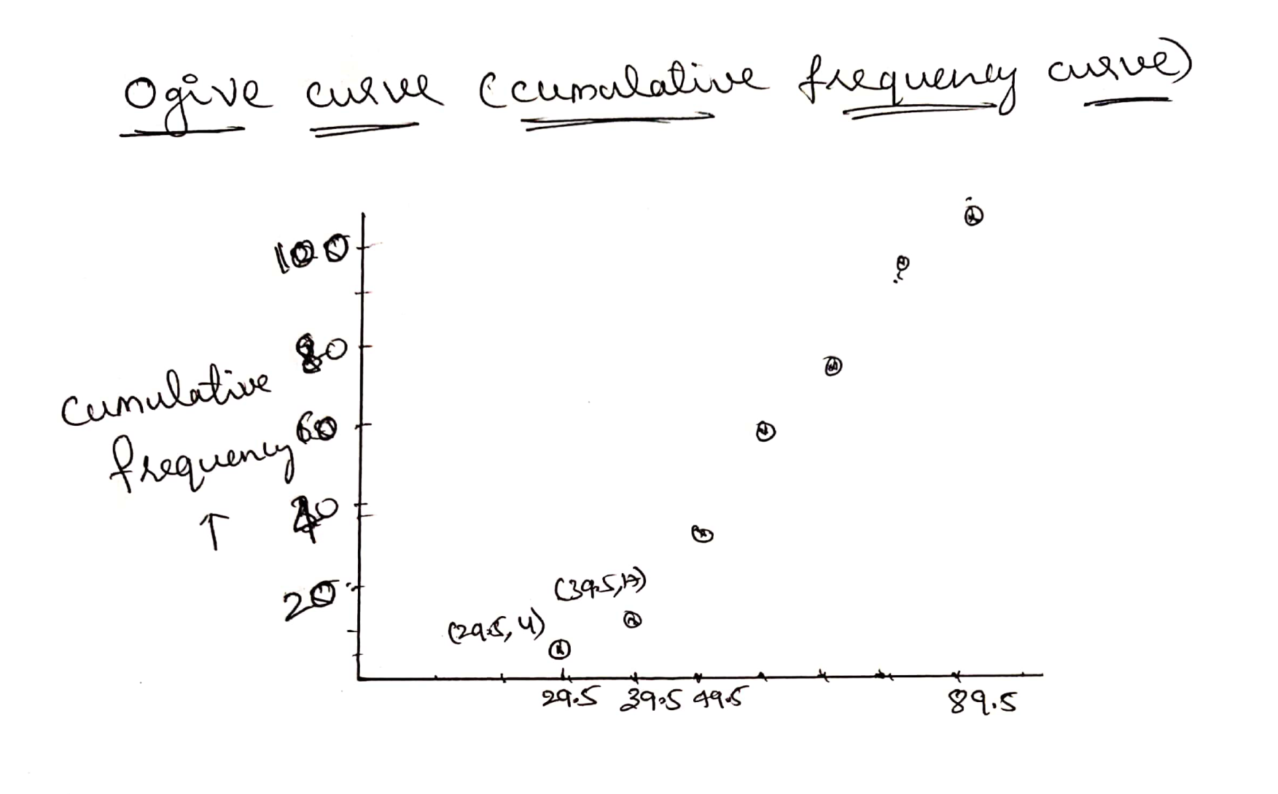
Construction of Ogive graph
Upper class limit

Slide 15
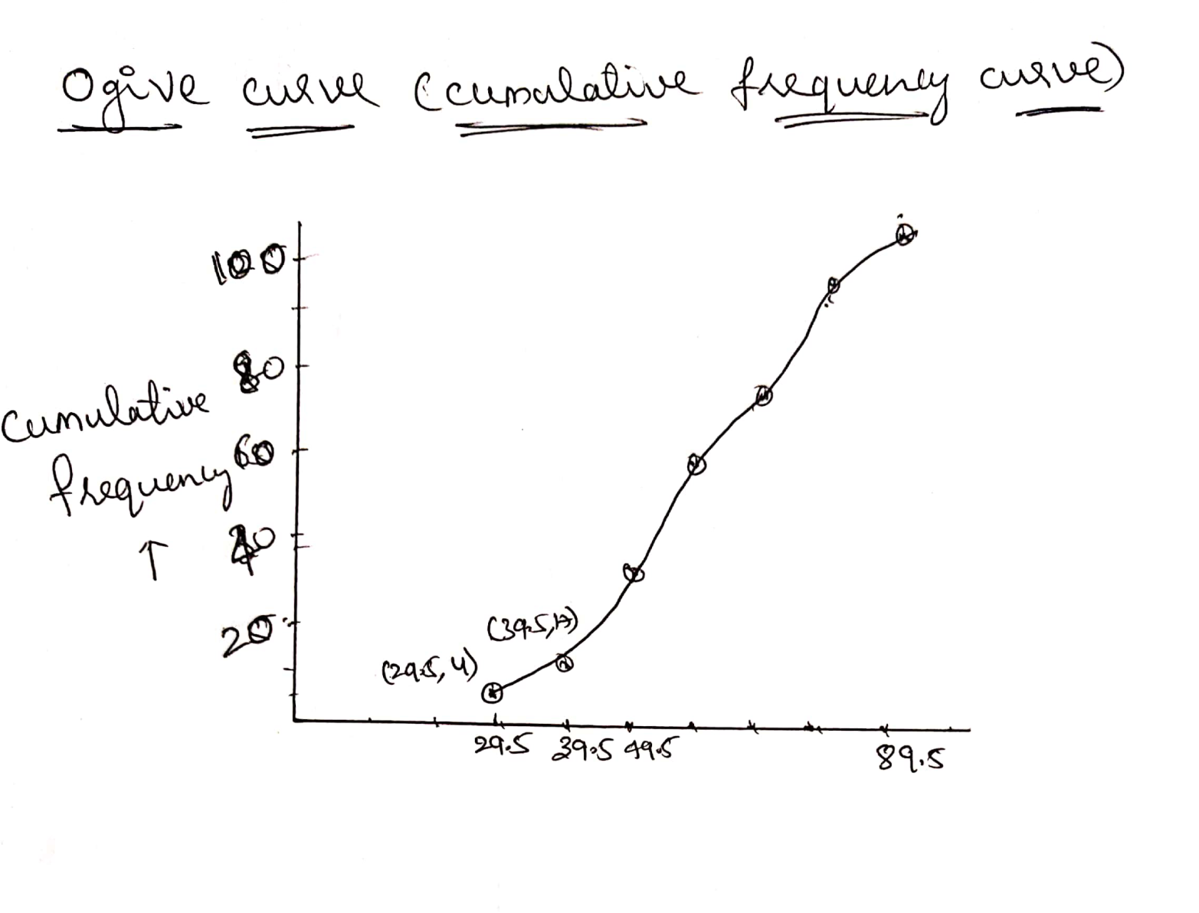
Construction of Ogive graph
Upper class limit

Slide 16
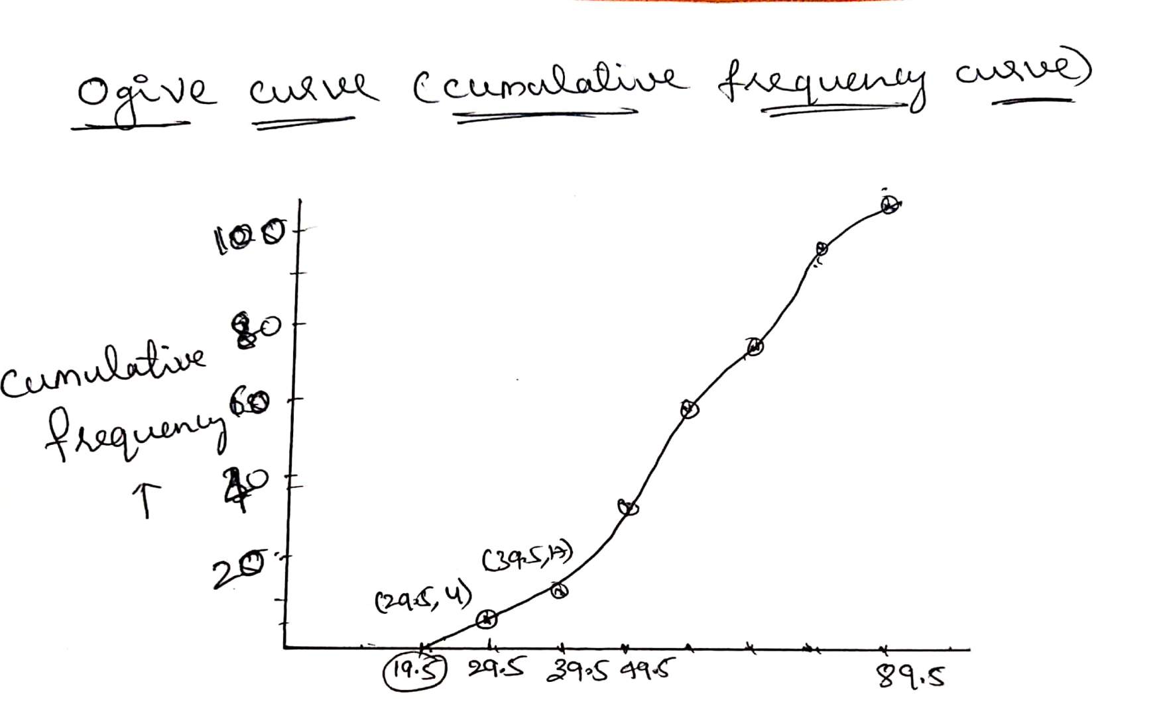
Construction of Ogive graph
Upper class limit

Slide 17
Types of Ogive graphs
The graphs of the frequency distribution are frequency graphs that are used to exhibit the characteristics of discrete and continuous data. Such figures are more appealing to the eye than the tabulated data. It helps us to facilitate the comparative study of two or more frequency distributions. We can relate the shape and pattern of the two frequency distributions.
The two methods of Ogives are:
Less than Ogive
Greater than or more than Ogive

Slide 18
Uses of Ogive
Ogive Graph or the cumulative frequency graphs are used to find the median of the given set of data. If both, less than and greater than, cumulative frequency curve is drawn on the same graph, we can easily find the median value. The point in which, both the curve intersects, corresponding to the x-axis, gives the median value. Apart from finding the medians, Ogives are used in computing the percentiles of the data set values.

Slide 19
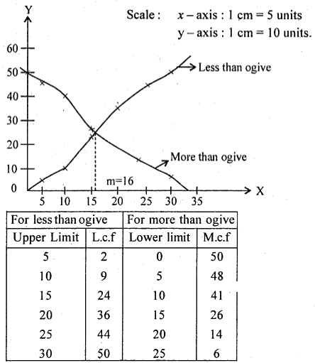
Example

Slide 20
Stem and Leaf Plot
It is a special table where each data value is split into a "stem" (the first digit or digits) and a "leaf" (usually the last digit) The "stem" values are listed down, and the "leaf" values go right (or left) from the stem values. The "stem" is used to group the scores and each "leaf" shows the individual scores within each group.

Slide 21
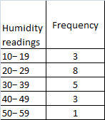
To illustrate, consider the following humidity readings rounded to the nearest percent: 29 44 12 53 21 34 39 25 48 23 17 24 27 32 34 15 42 21 28 37 we might group these data into the following distribution:

Slide 22
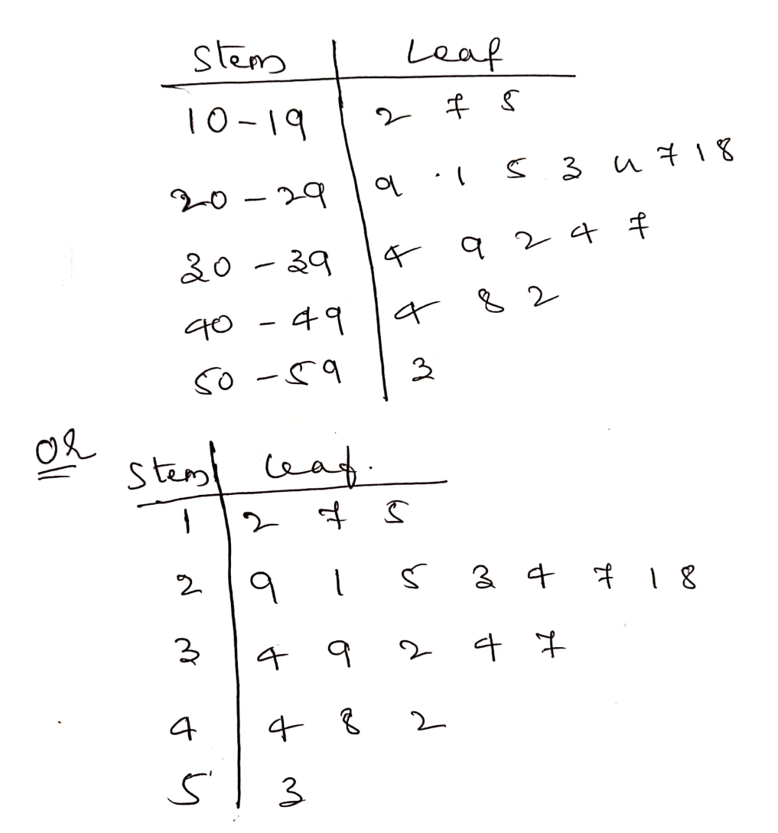
If we wanted to avoid the loss of information inherent in the preceding table, we could keep track of the last digits of the readings within each class, getting

Slide 23
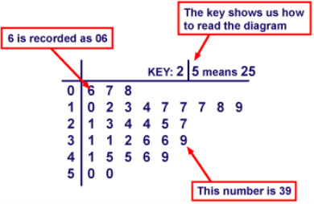
How to read a stem and leaf chart

